Slide 1


Slide 2


THE SOUND OF POPULARITY
Viet Nguyen | Nicolas Nguyen

Slide 3


RATIONALE
Baby Shark - 2018
As It Was - 2022

Slide 4


Research Question
How do various factors influence the popularity of a song, as indicated by its total stream count on Spotify?

Slide 5
PROCESS
Data Acquisition
Data Sourcing
Data Cleaning
1
Data Analysis
Data Examination
Model Optimization
Validating Assumptions
Model Interpretation & Insights
Prediction & Evaluation on Test Set
2

Slide 6
1
DATA ACQUISITION

Slide 7
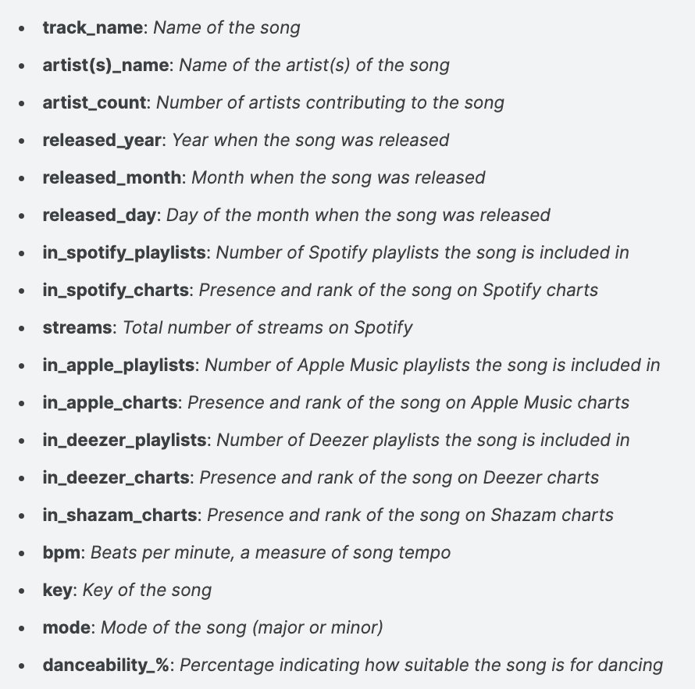

DATA SOURCE
“Most Streamed Spotify Songs 2023”
Notes:
Out of the predictor variables, we expect the year the song was released, its beats per minute and the number of Spotify playlists the song is included in to have the biggest effect on its 2023 stream count.

Slide 8
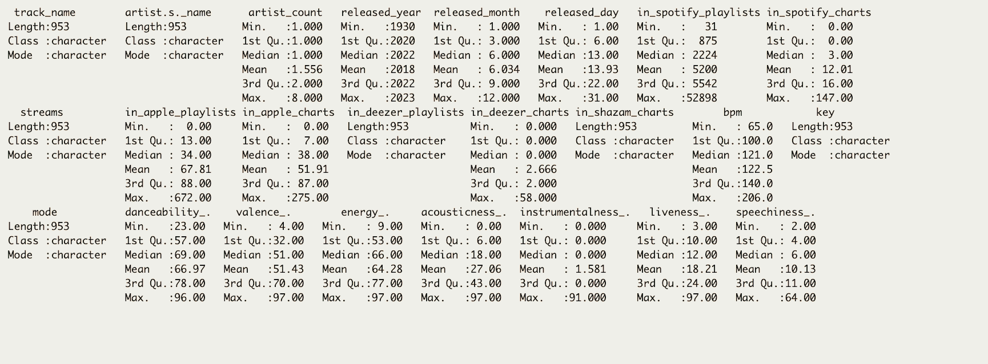
DATA CLEANING

Slide 9
2
DATA ANALYSIS

Slide 10
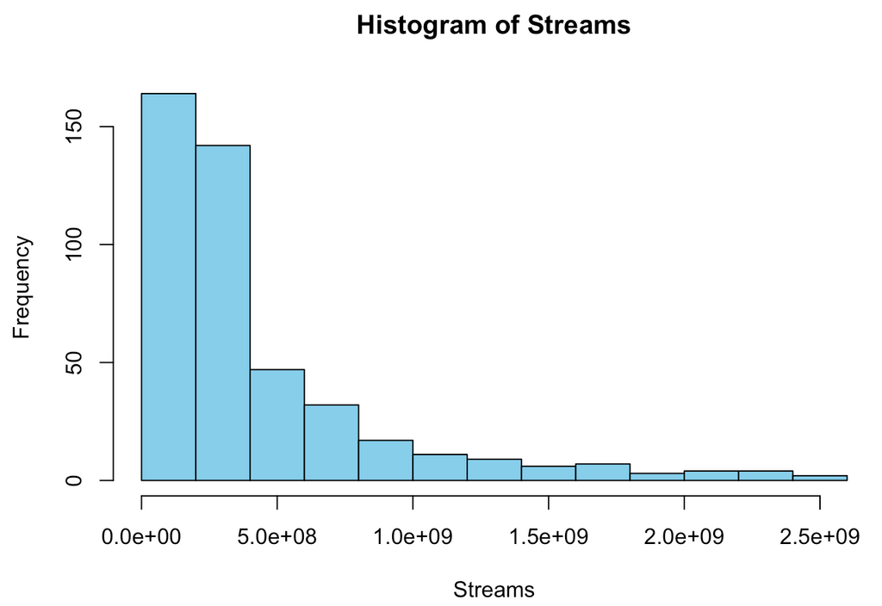
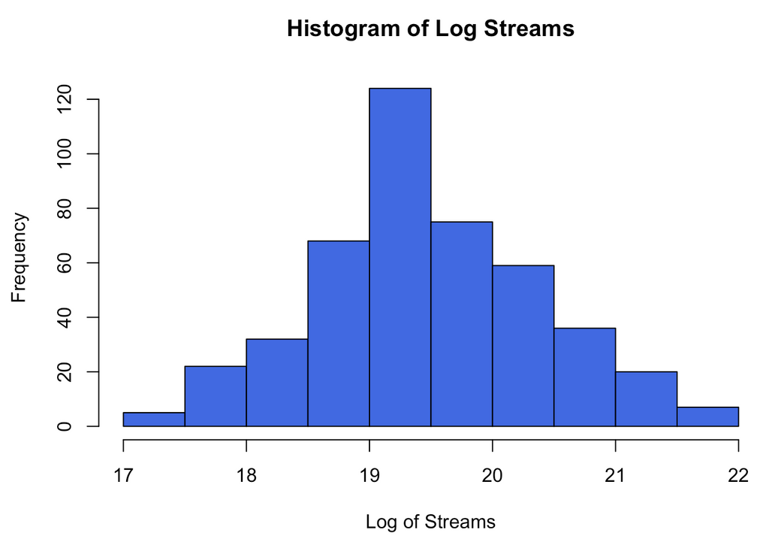
Y VARIABLE - TOTAL STREAMS ON SPOTIFY

Slide 11
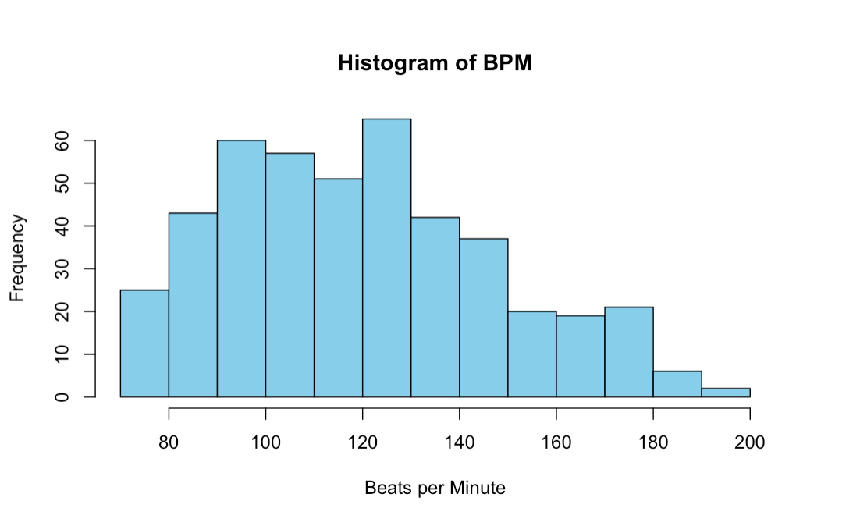
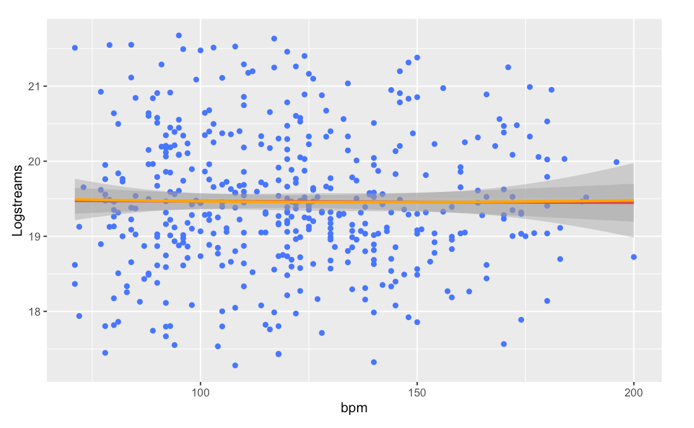
X VARIABLE - BEATS PER MINUTE

Slide 12
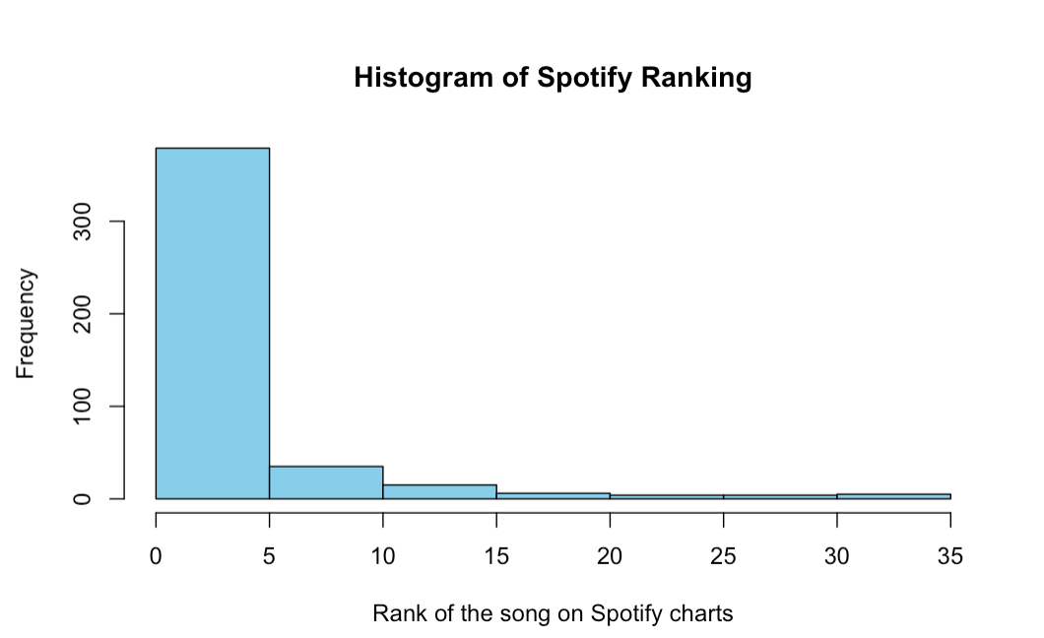
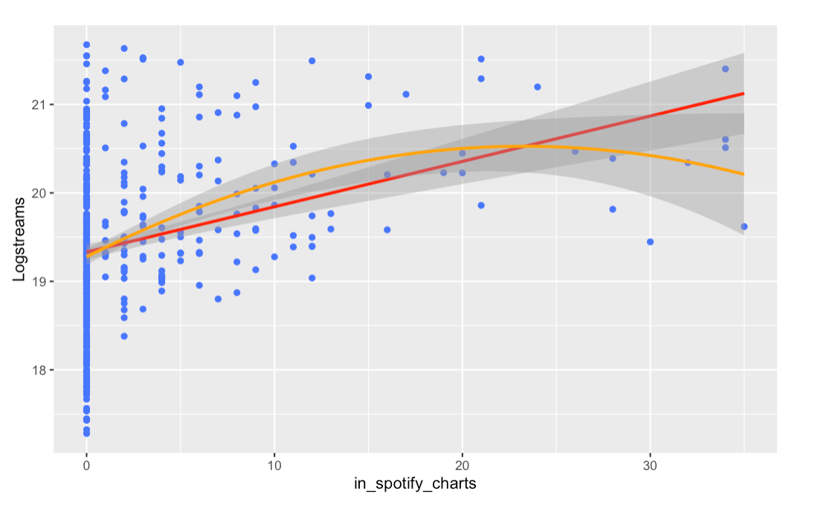
X VARIABLE - Song rank on Spotify’s viral charts

Slide 13
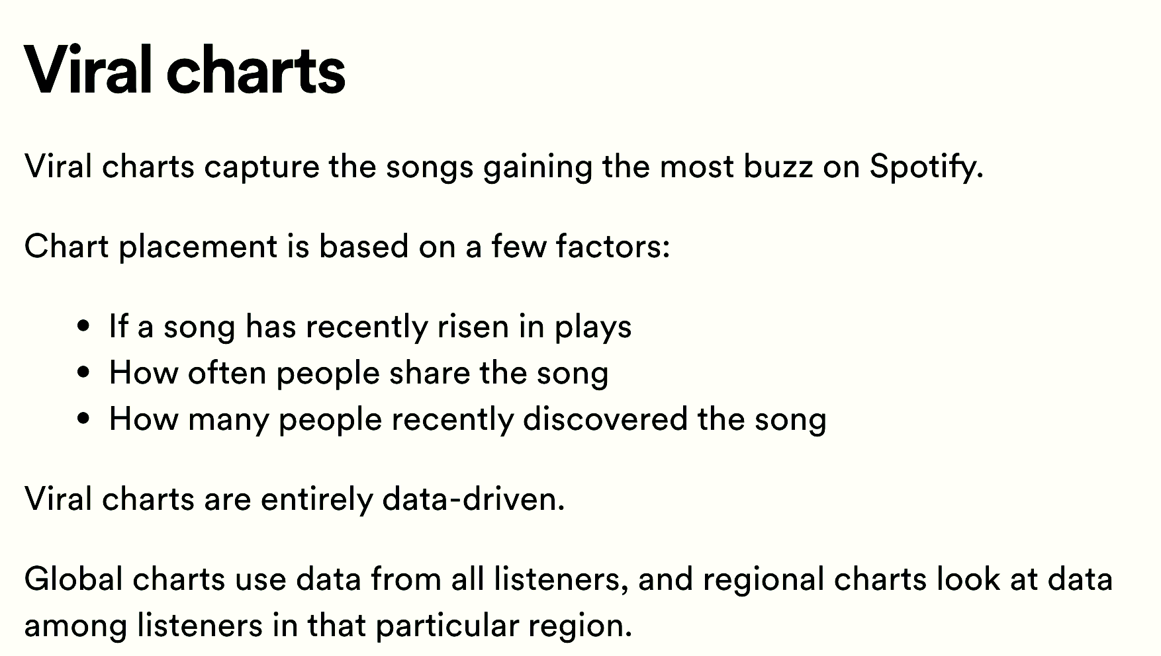

Slide 14
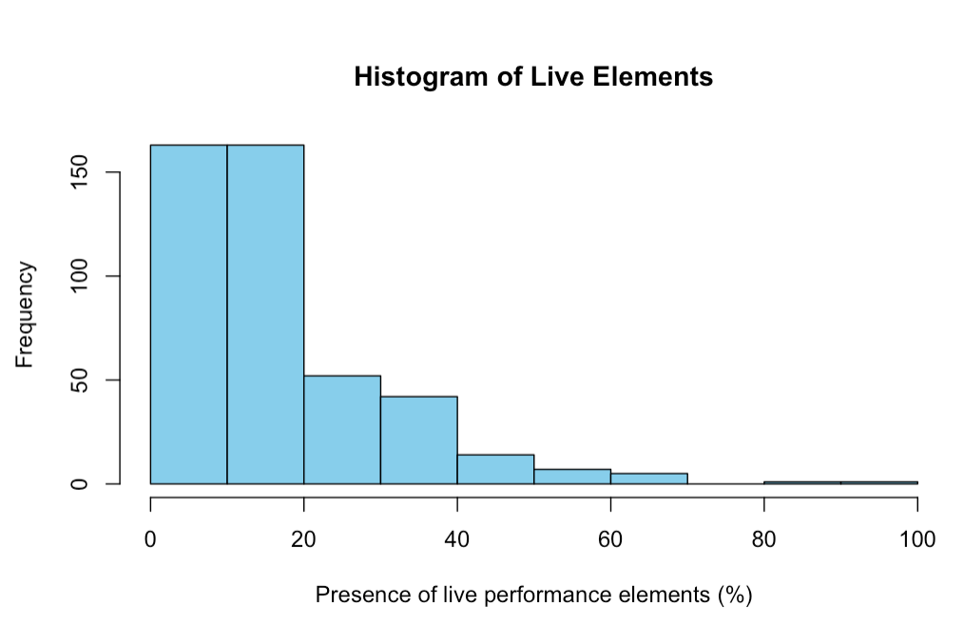
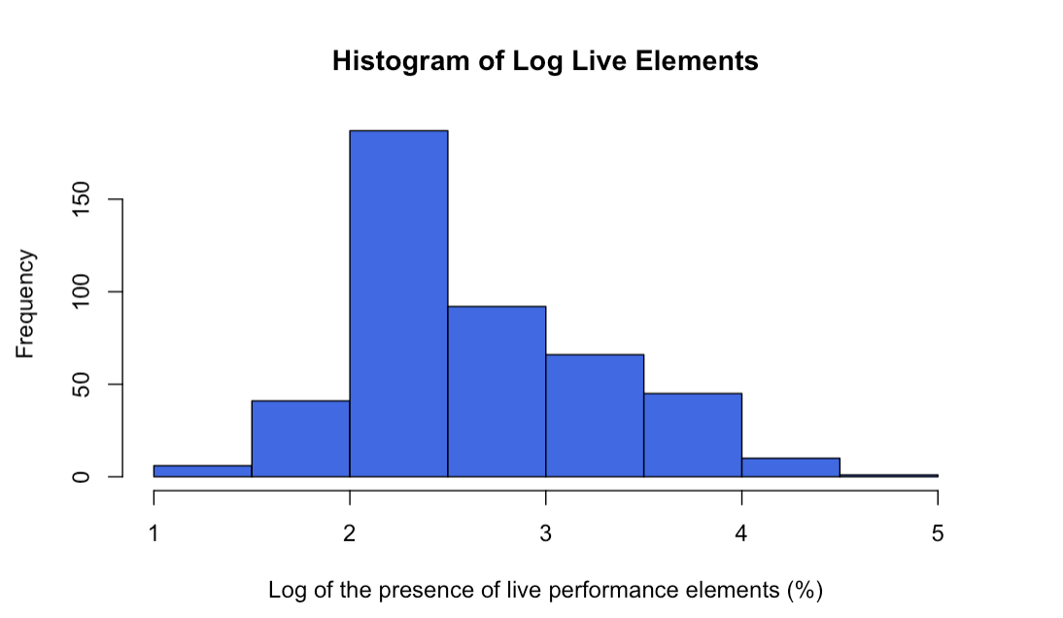
X VARIABLE - LIVE PERFORMENCE ELEMENTS

Slide 15
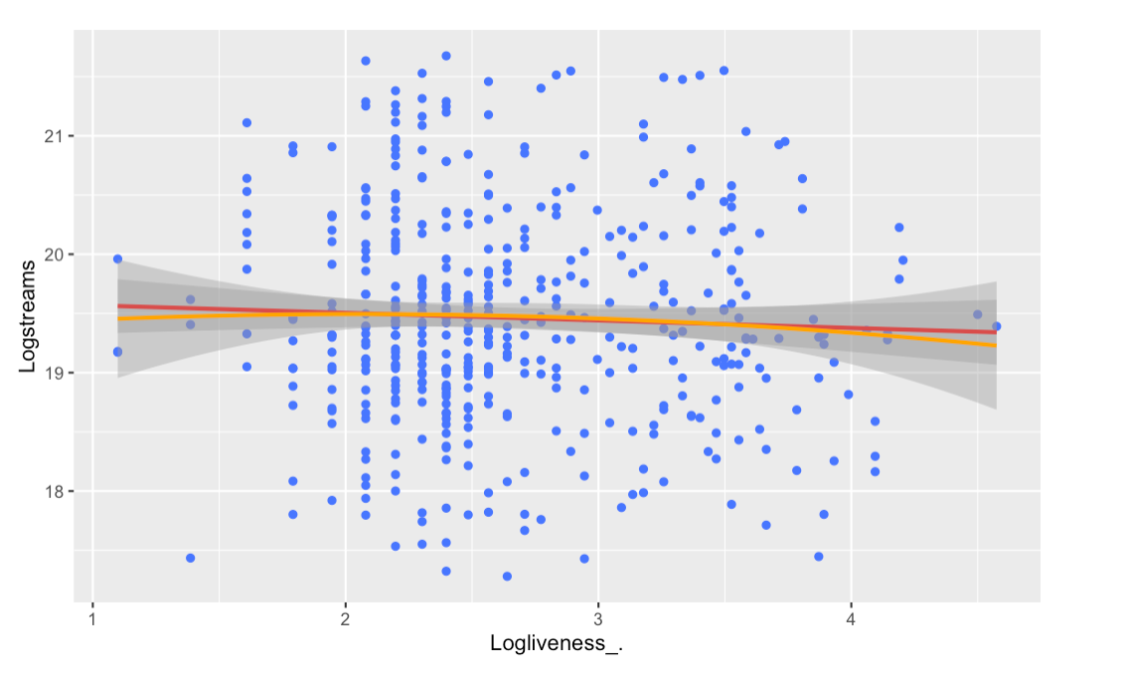
X VARIABLE - LIVE PERFORMENCE ELEMENTS

Slide 16
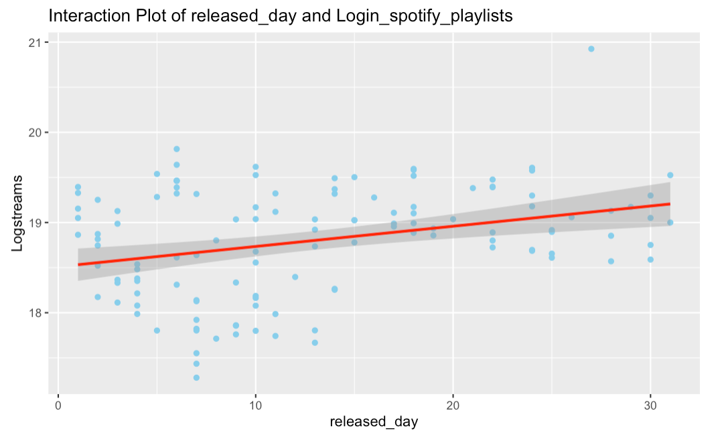
INTERACTION PLOT

Slide 17
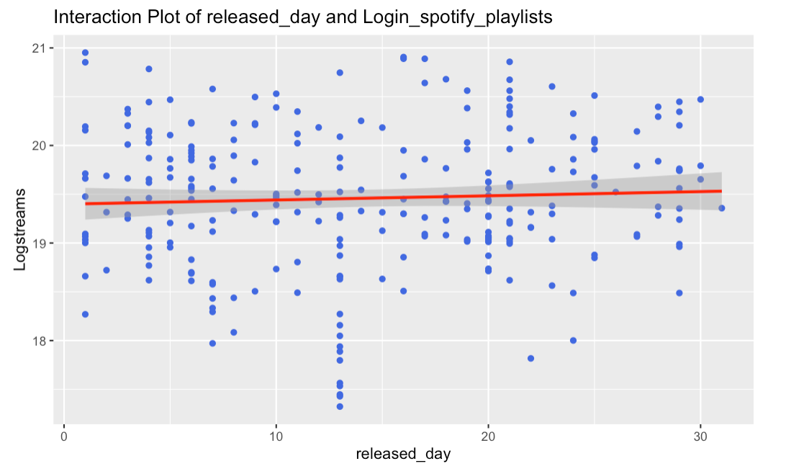
INTERACTION PLOT

Slide 18
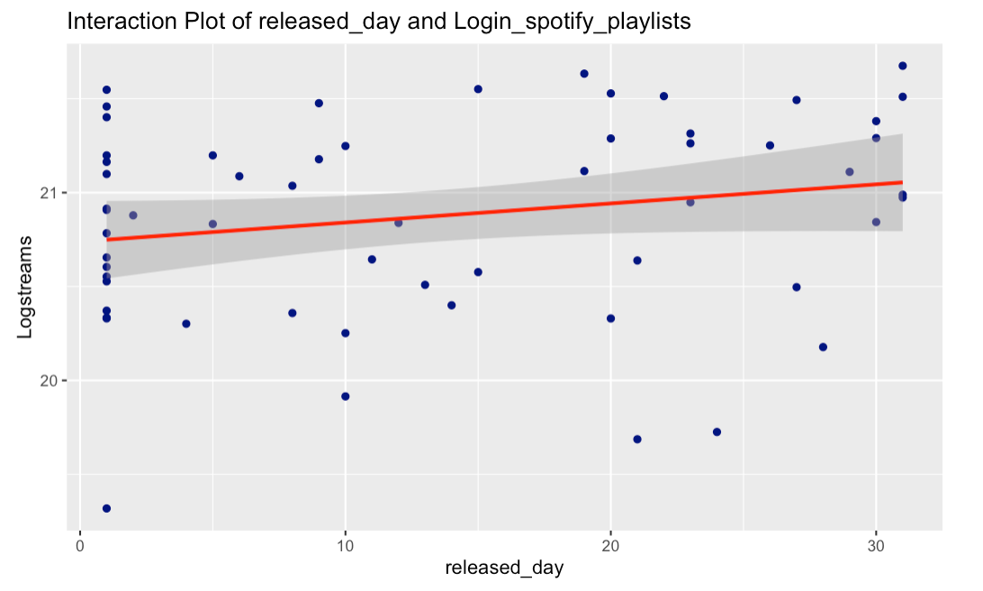
INTERACTION PLOT

Slide 19
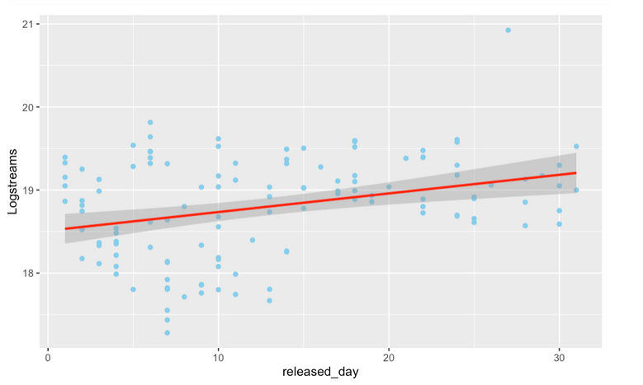
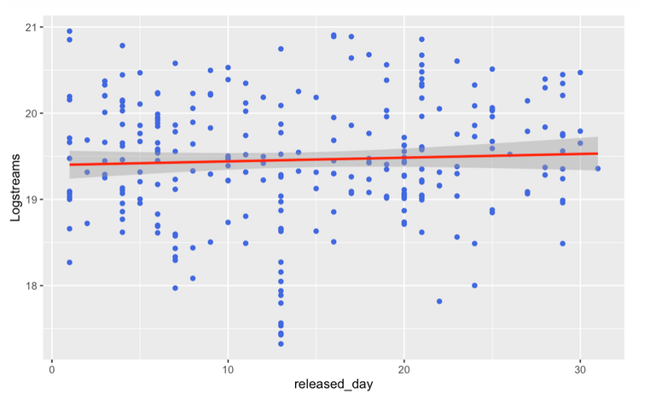
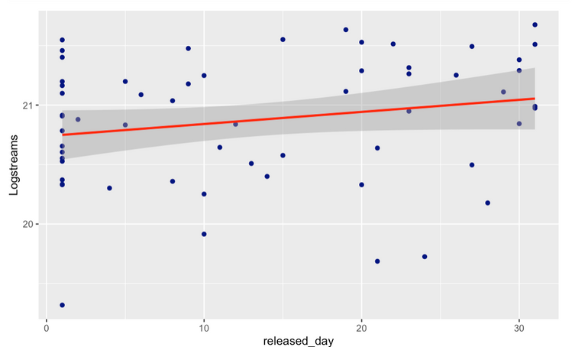
INTERACTION PLOT

Slide 20
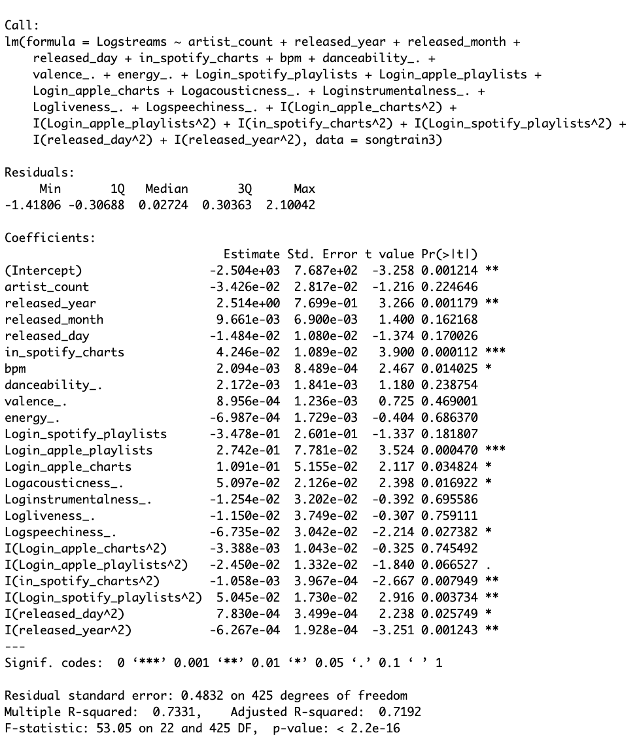
MODEL OPTIMIZATION
Saturated Model
We start our analysis with a saturated model consisting of 22 variables. By examining the p-values of each coefficient, we progressively refine the model going backward until all included variables have statistically significant impacts on the outcome.

Slide 21
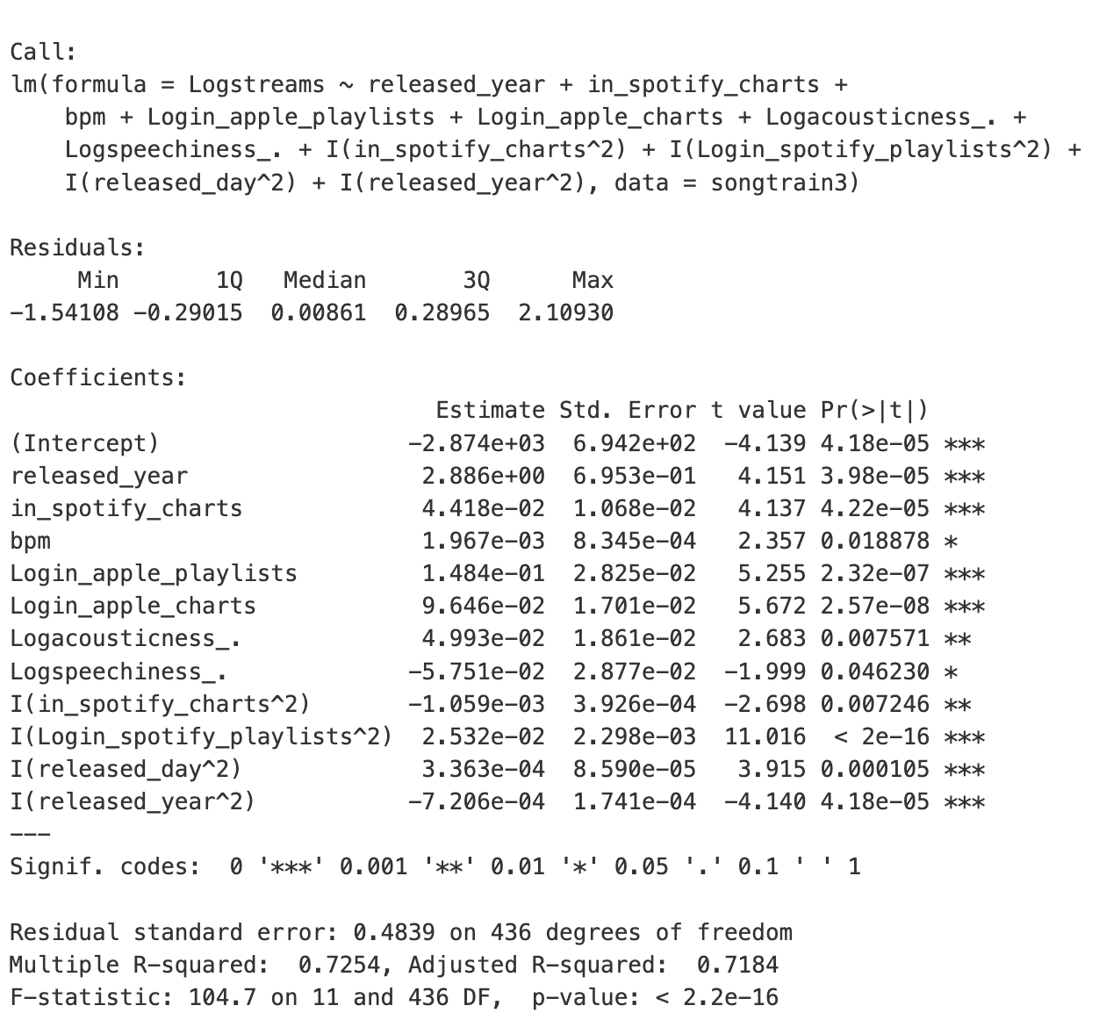
MODEL OPTIMIZATION
Best
Model
After iterative refinement, we reach a final model with 11 variables, each demonstrating statistically significant impacts on song popularity on Spotify.

Slide 22
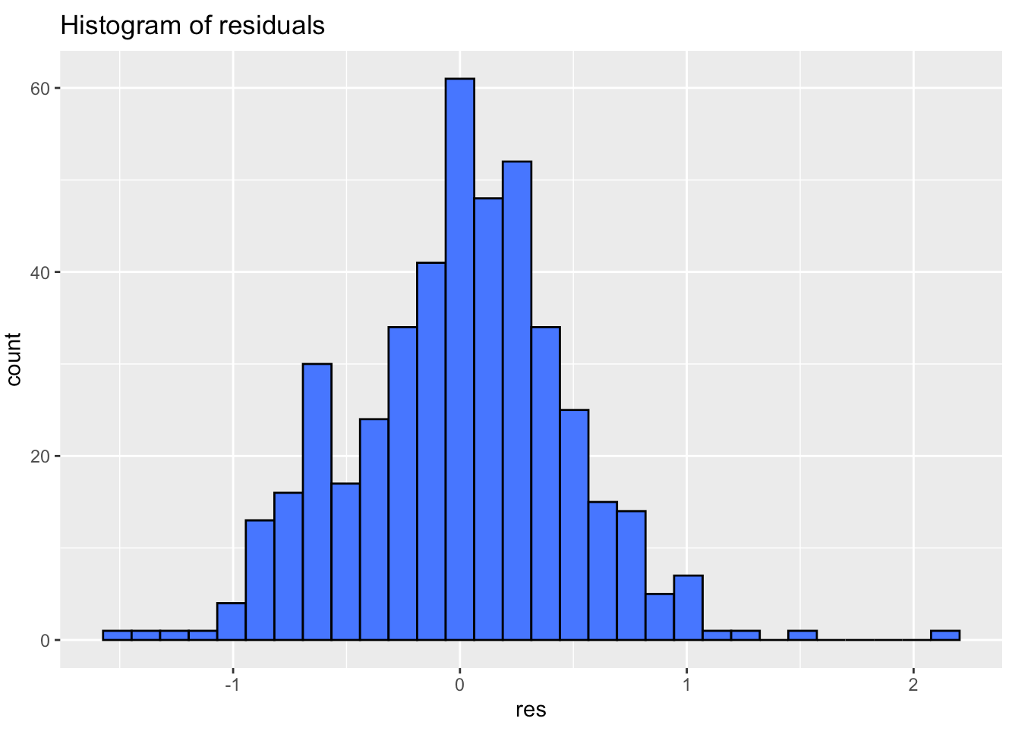
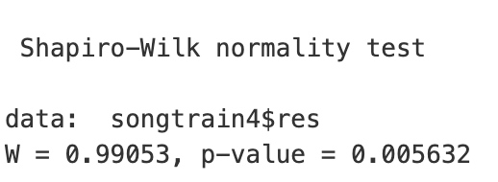
NORMALITY ASSUMPTION

Slide 23
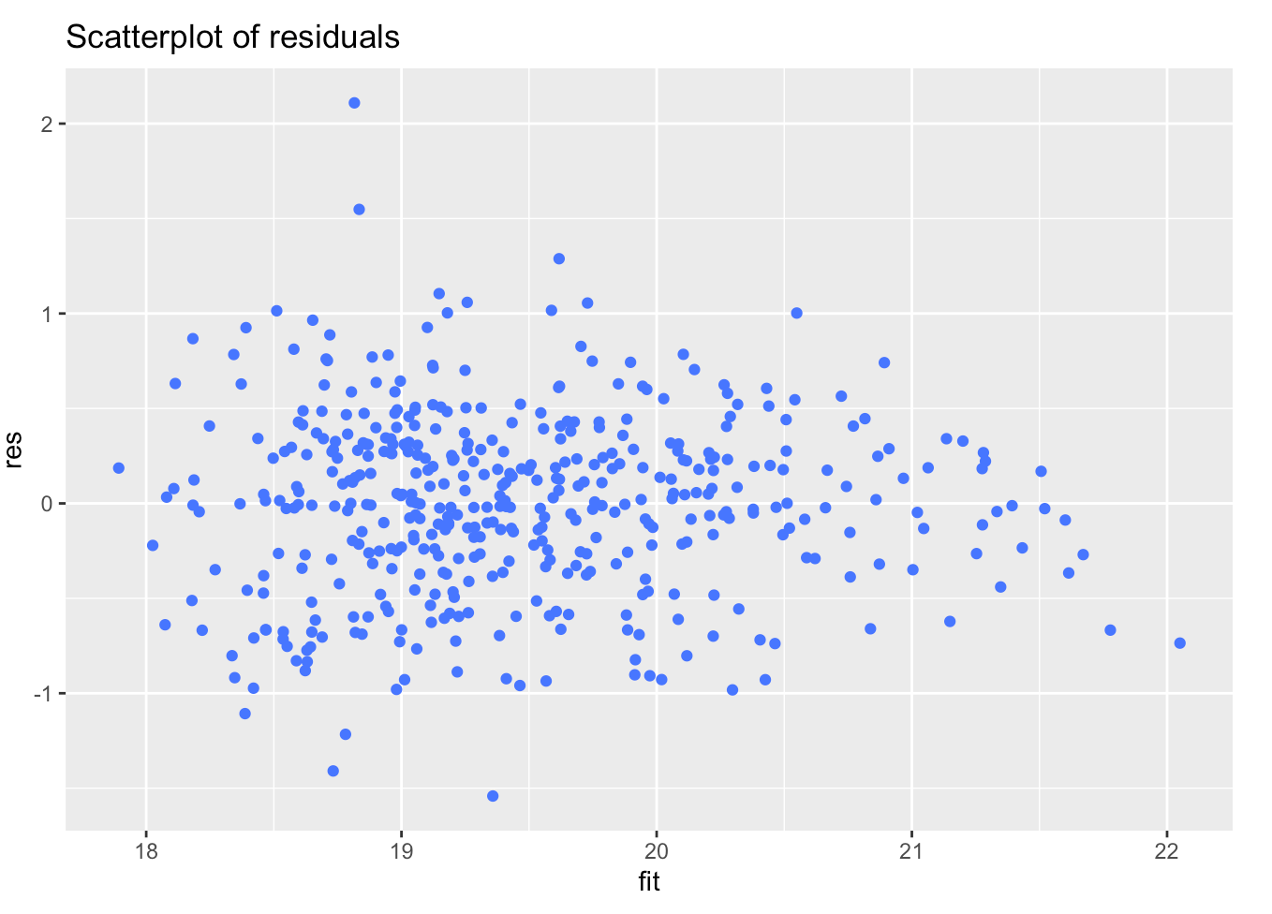
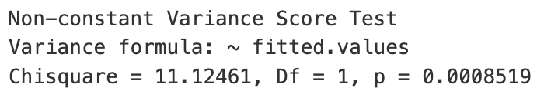
HOMOSCEDASTICITY ASSUMPTION

Slide 24
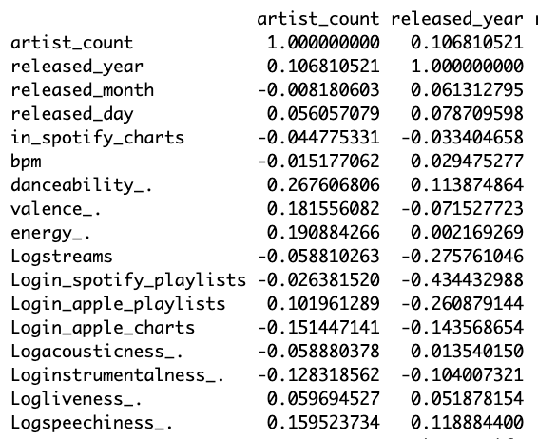
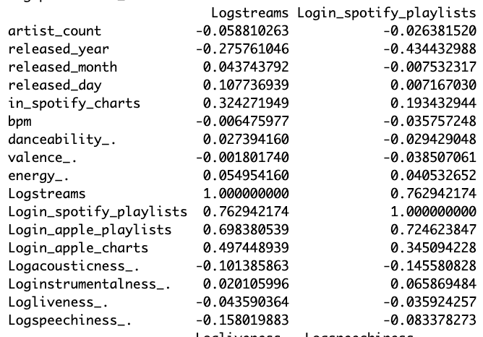
INDENDENCE ASSUMPTION

Slide 25
MODEL INTERPRETATION

Slide 26

KEY INSIGHTS
YEAR RELEASED
For every one-unit increase in the release year, the number of streams the song accumulated increases by 1600%
1600%
PRESENCE IN APPLE MUSIC PLAYLISTS
For every additional Apple Music playlist the song is included in, its Spotify stream count increases by 27%
27%
SPEECHINESS
For every additional word spoken, the stream count decreases by 6%
6%

Slide 27
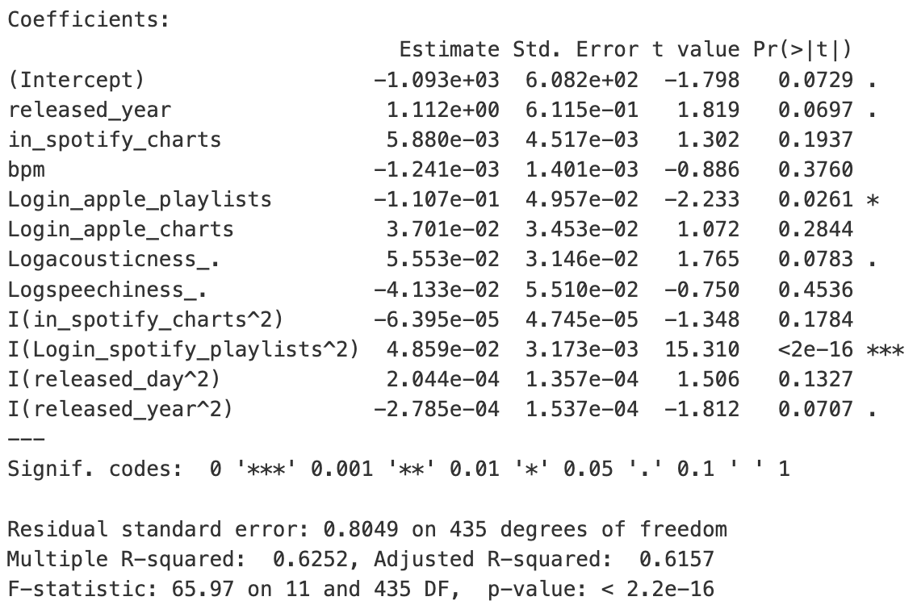
MODEL EVALUATION ON TEST SET

Slide 28
LIMITATIONS
Multicollinearity: The dataset may suffer from multicollinearity, where predictor variables are highly correlated with each other (independence assumption)
Small Sample Size: After splitting, the training dataset only has ~450 data points, which could have affected the generalizability of findings
Overfitting: After evaluating the training model on the test set, it seems that overfitting is evident, as the “best” model fails to generalize to new data due to too much noise being captured and/or random fluctuations.

Slide 29
Future Extensions
How does collaboration between artists influence the popularity of songs on streaming platforms like Spotify?

Slide 30

Thank you!

